Slide 1


Microsoft Azure Security Technologies (AZ-500) Bootcamp
Get Certified as an Azure Security Engineer Associate
December/2022

Slide 2

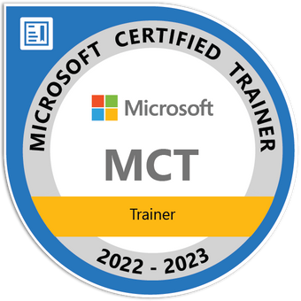
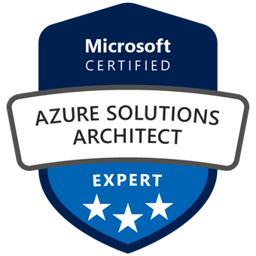
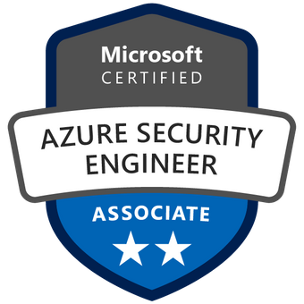
Reza Salehi
Cloud Consultant and Trainer
@zaalion

Slide 3
Course Overview

Slide 4

AZ-500 Bootcamp
Day 1
Manage identity and access
Implement platform protection

Slide 5
AZ-500 Bootcamp
Day 2
Manage security operations
Secure data and applications

Slide 6
Course Repository
https://github.com/zaalion/oreilly-az-500

Slide 7
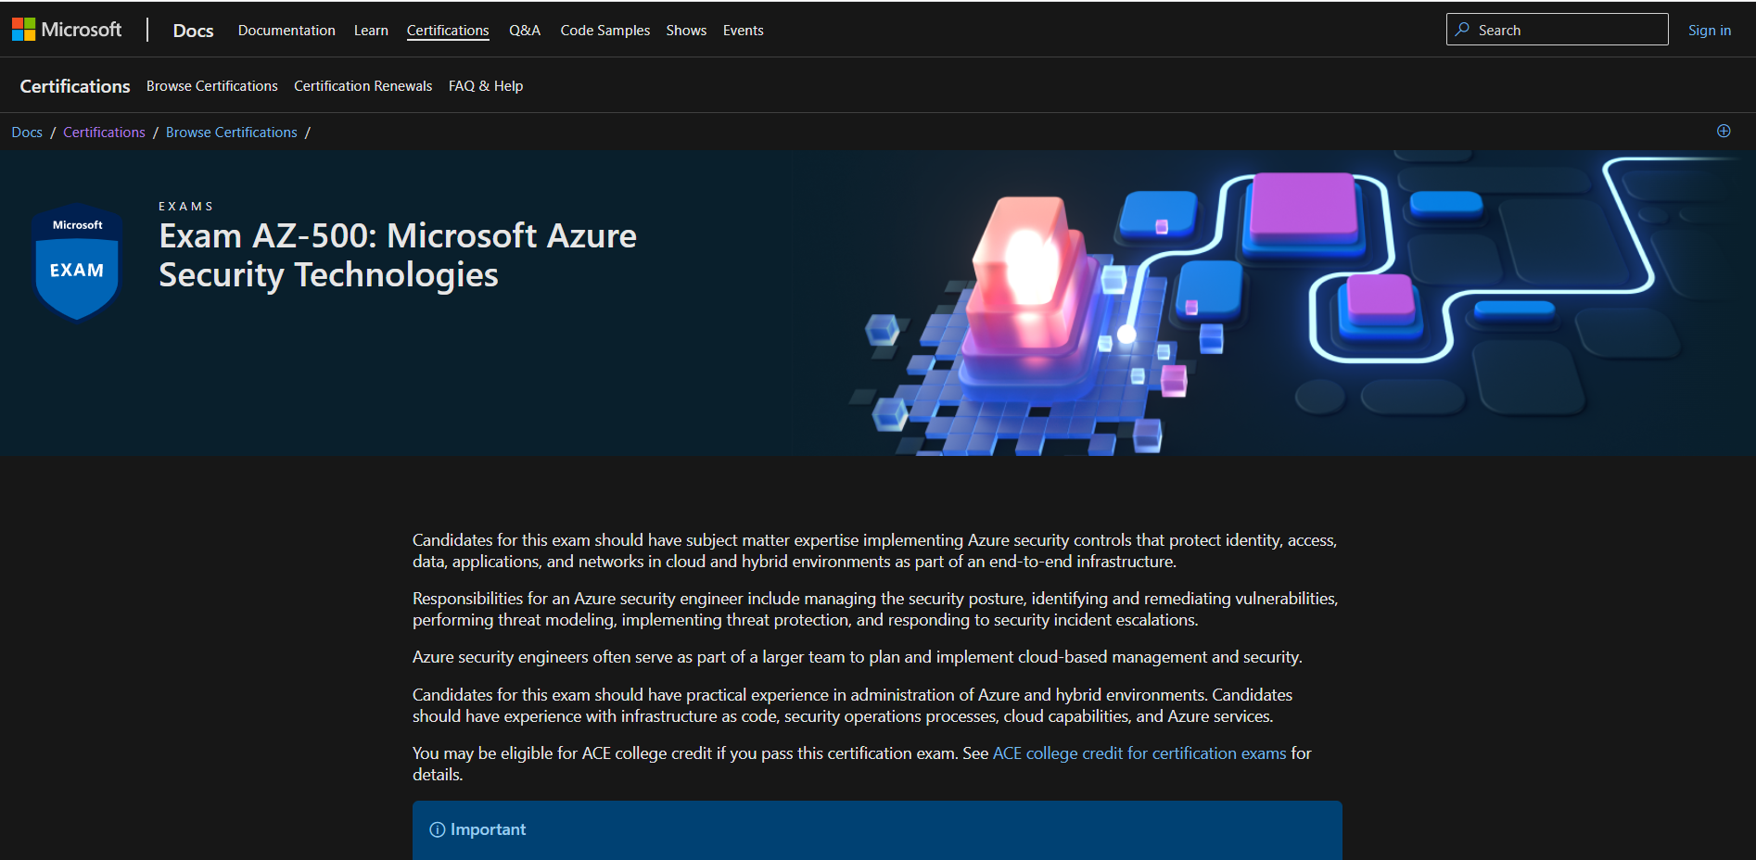
Course Repository
https://github.com/zaalion/oreilly-az-500

Slide 8
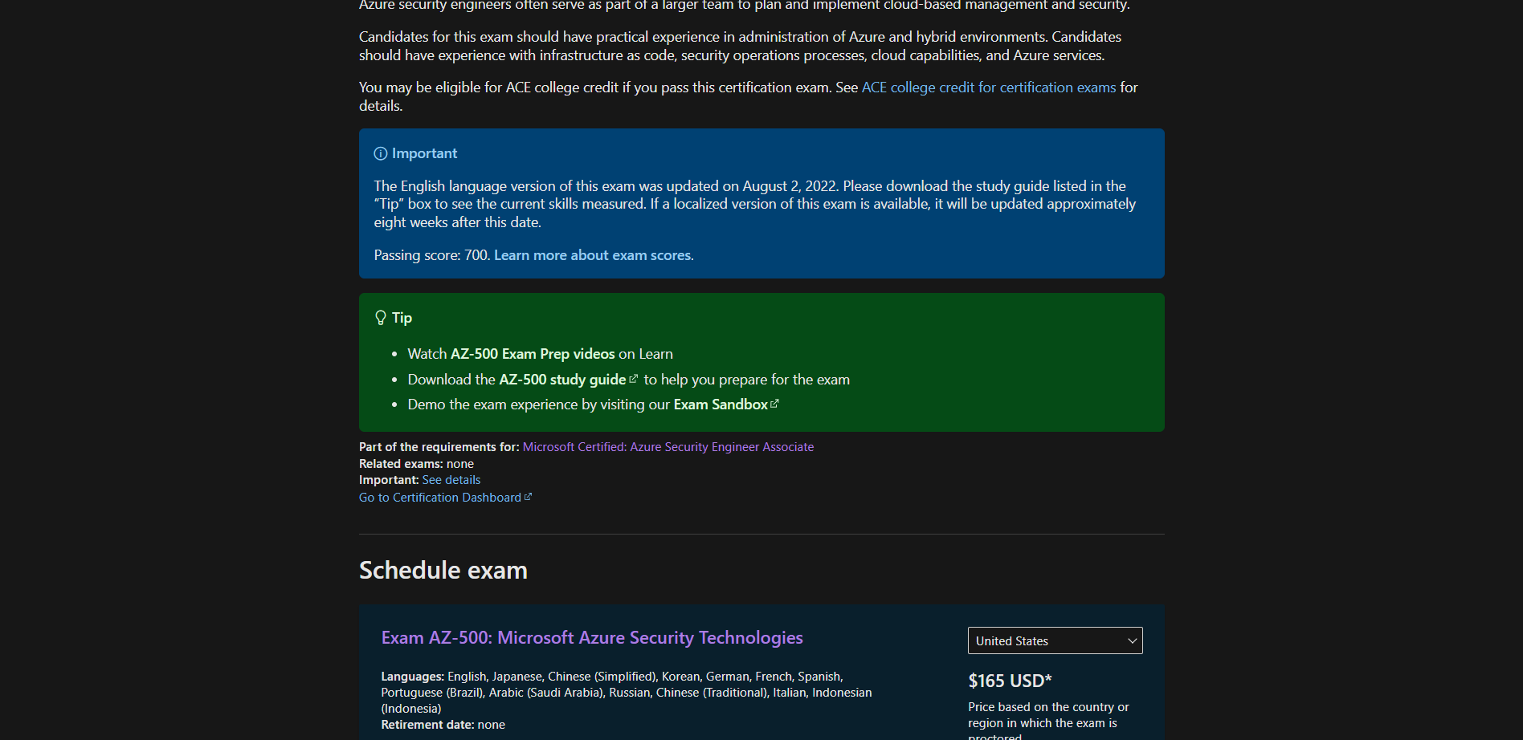
Course Repository
https://github.com/zaalion/oreilly-az-500

Slide 9
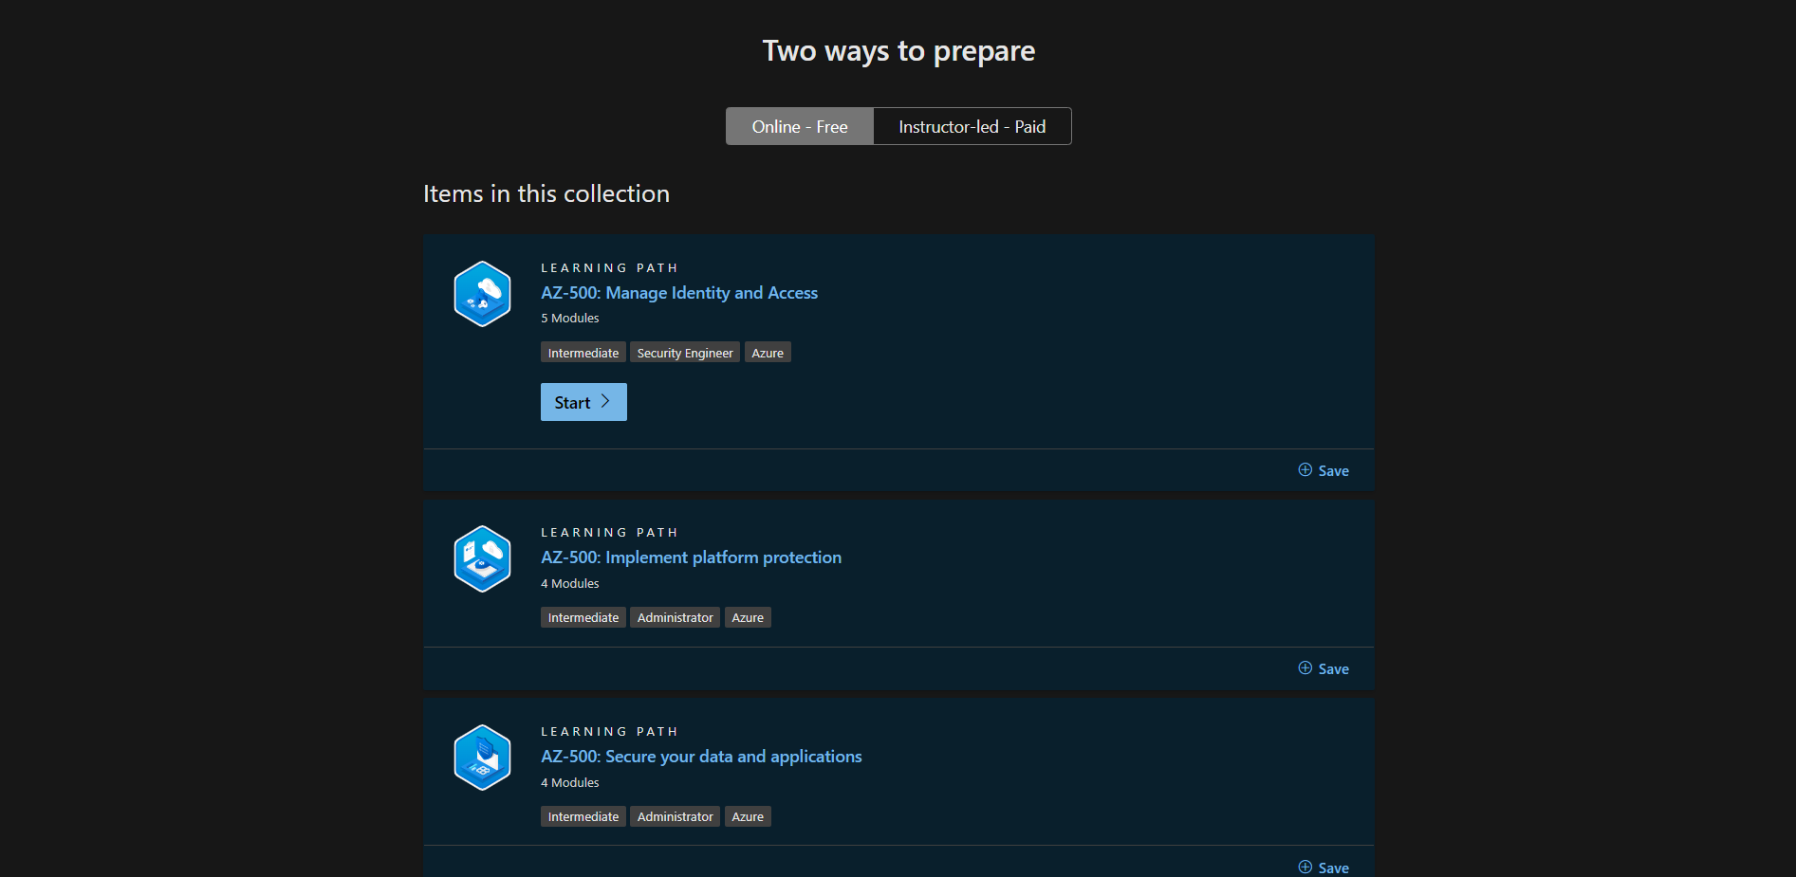
Course Repository
https://github.com/zaalion/oreilly-az-500

Slide 10
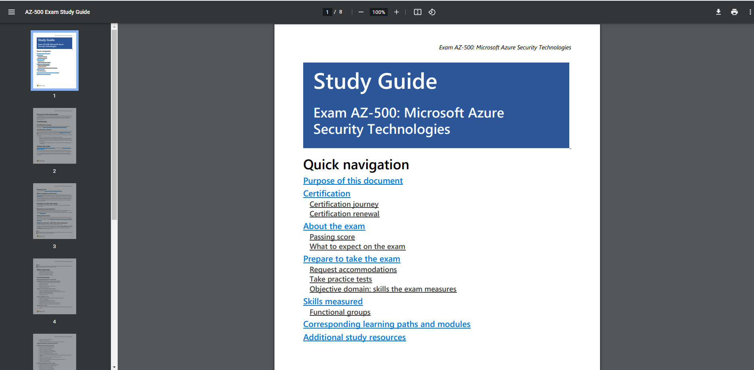
Course Repository
https://github.com/zaalion/oreilly-az-500

Slide 11
Day 1

Slide 12
Azure Fundamentals Bootcamp
Manage identity and access (30-35%)
Implement platform protection (15-20%)

Slide 13
Manage Identity and Access (30–35%)
Manage Azure Active Directory (Azure AD) identities
Manage secure access by using Azure AD
Manage application access
Manage access control

Slide 14
Manage Azure Active Directory (Azure AD) Identities
Create and manage a managed identity for Azure resources
Manage Azure AD groups
Manage Azure AD users
Manage external identities by using Azure AD
Manage administrative units

Slide 15
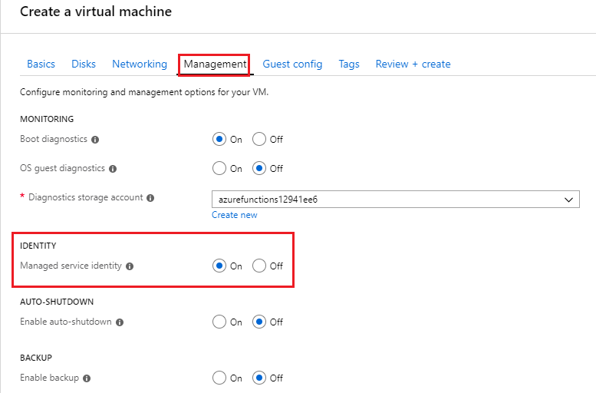

Slide 16
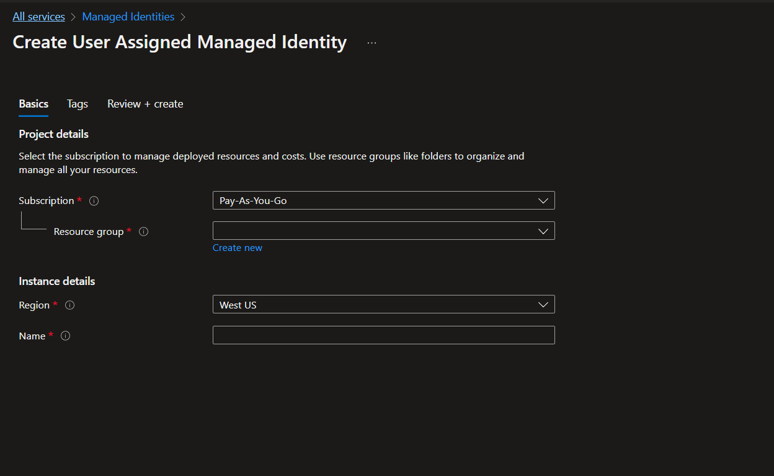

Slide 17
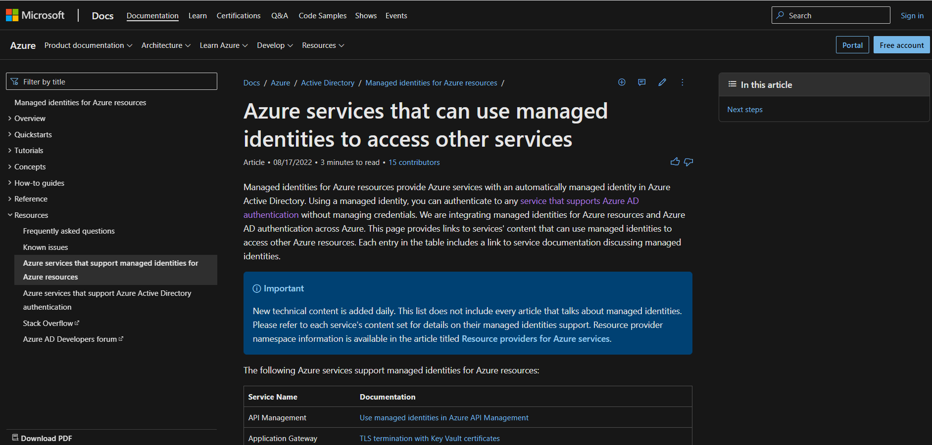

Slide 18
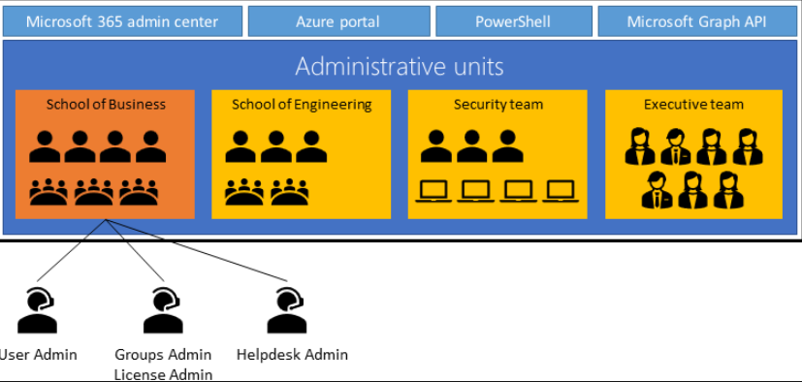

Slide 19
Manage Secure Access by Using Azure AD
Configure Azure AD Privileged Identity Management (PIM)
Implement Conditional Access policies, including multifactor authentication
Implement Azure AD Identity Protection
Implement passwordless authentication
Configure access reviews (and see these ones too)

Slide 20
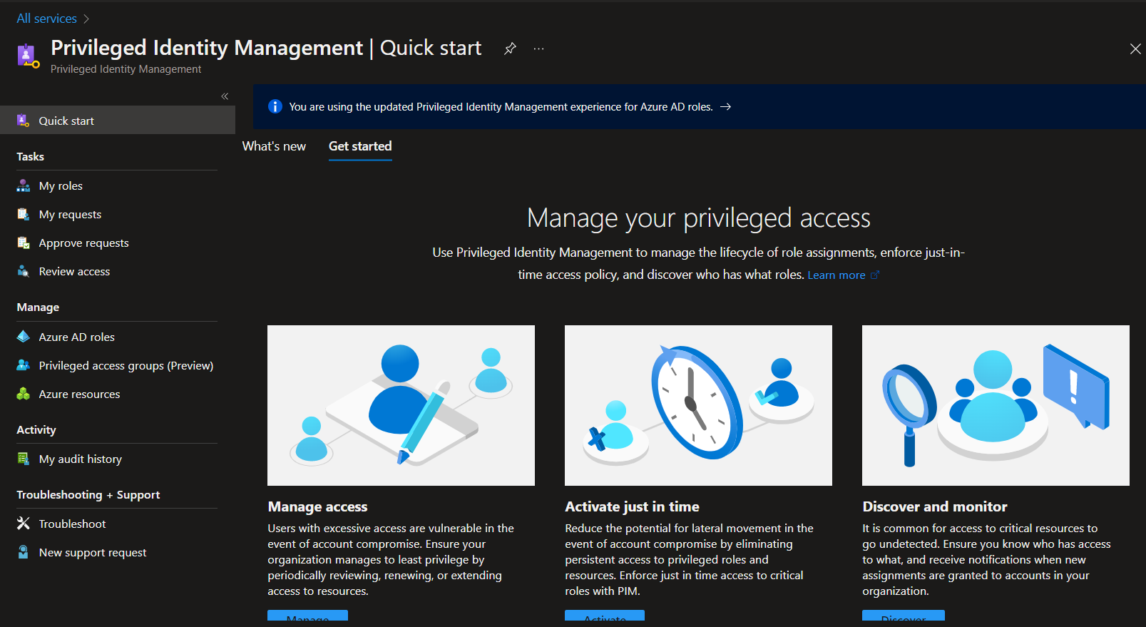

Slide 21
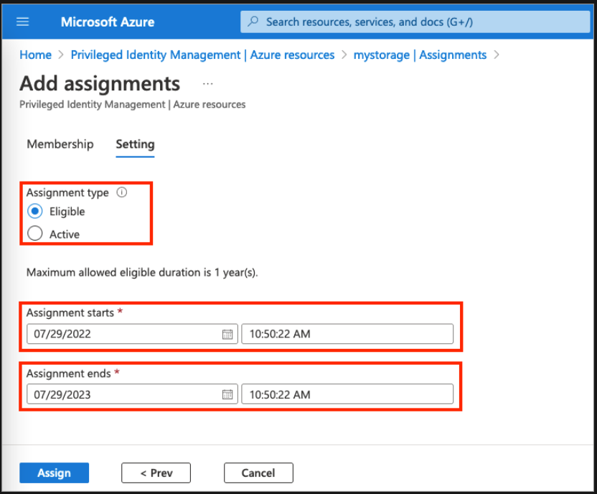

Slide 22
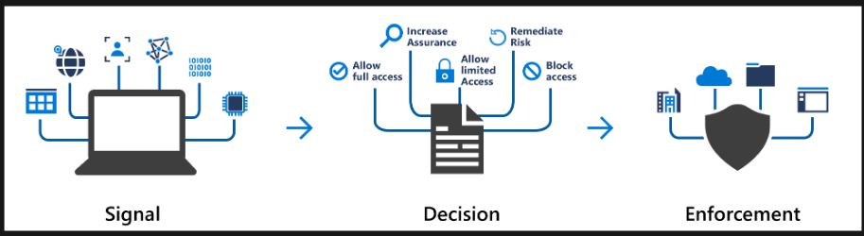
Azure AD Conditional Access

Slide 23
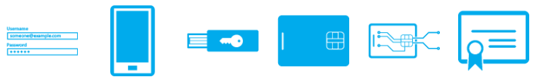
Azure AD Multi-Factor Authentication

Slide 24
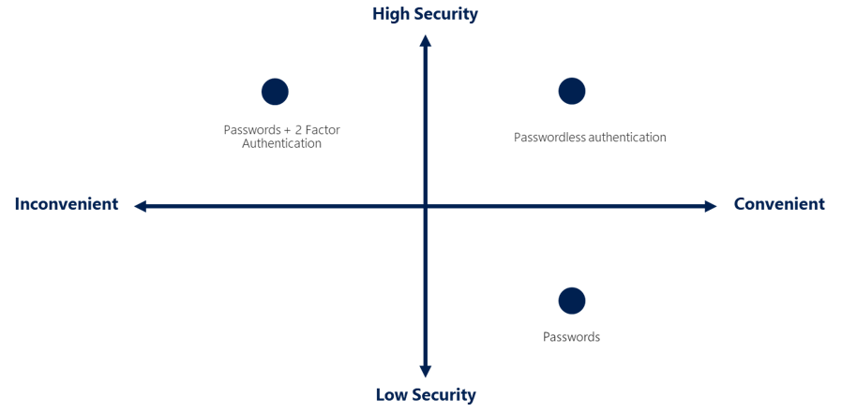
Passwordless authentication options for AAD

Slide 25
Manage Application Access
Integrate single sign-on (SSO) and identity providers for authentication
Create an app registration
Configure app registration permission scopes
Manage app registration permission consent
Manage API permissions to Azure subscriptions and resources
Configure an authentication method for a service principal

Slide 26
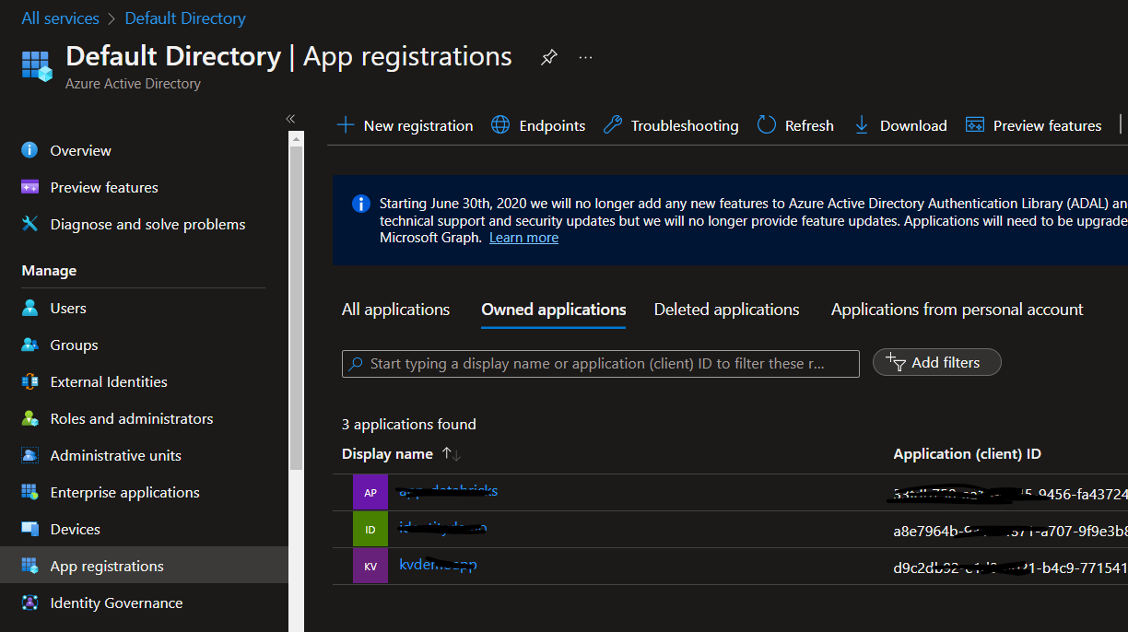
Passwordless authentication options for AAD

Slide 27
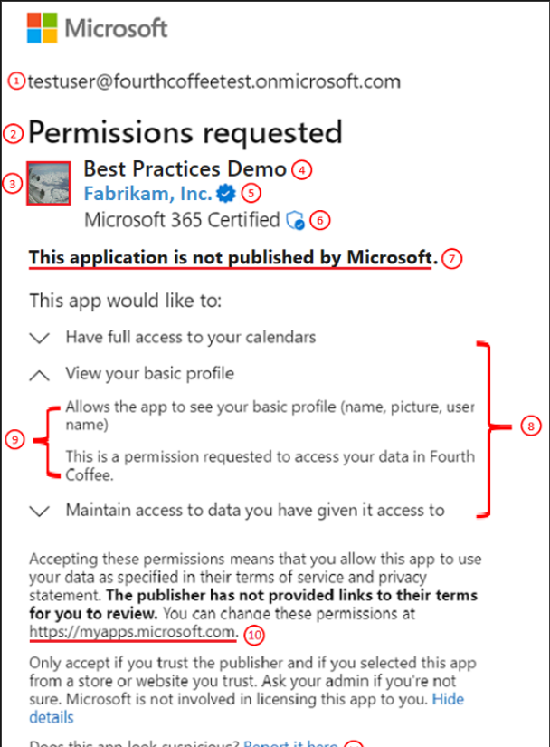

Slide 28
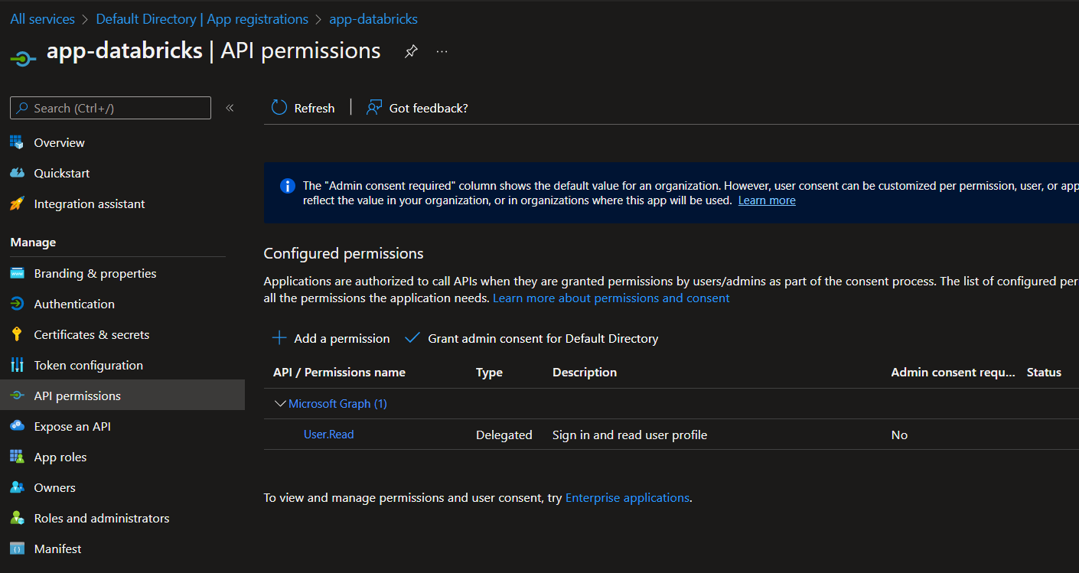

Slide 29
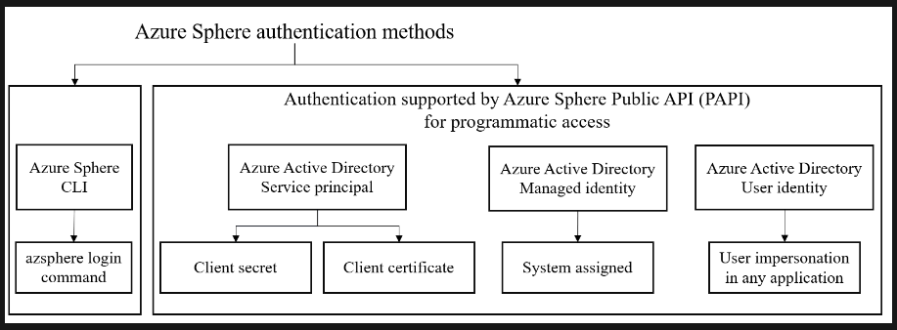

Slide 30
Manage Access Control
Configure Azure role permissions for management groups, subscriptions, resource groups, and resources
Interpret role and resource permissions
Assign built-in Azure AD roles
Create and assign custom roles, including Azure roles and Azure AD roles

Slide 31
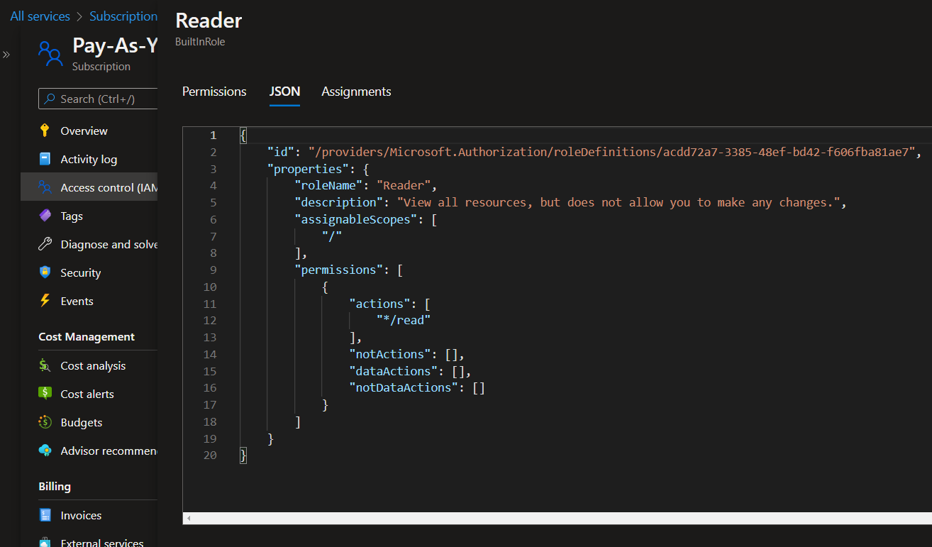

Slide 32
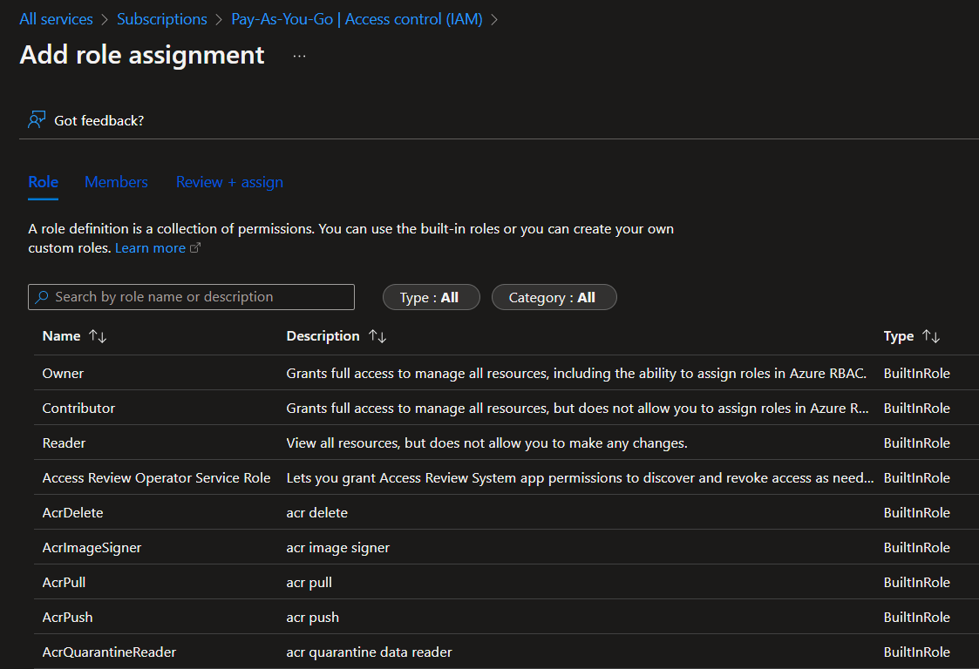

Slide 33
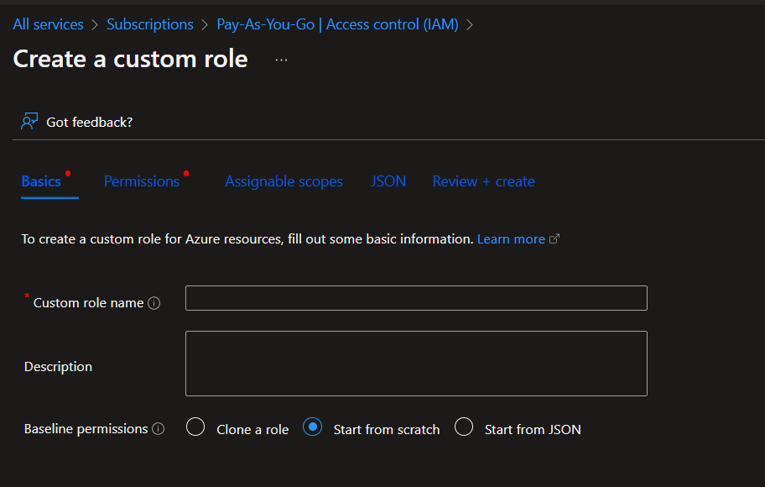

Slide 34
Implement Platform Protection (15–20%)
Implement advanced network security
Configure advanced security for compute

Slide 35
Implement Advanced Network Security
Secure the connectivity of hybrid networks
Secure the connectivity of virtual networks
Create and configure Azure Firewall
Create and configure Azure Firewall Manager
Create and configure Azure Application Gateway
Create and configure Azure Front Door
Create and configure Web Application Firewall (WAF)
Configure a resource firewall, including storage account, Azure SQL, Azure Key Vault, or Azure App Service
Configure network isolation for Web Apps and Azure Functions
Implement Azure Service Endpoints
Implement Azure Private Endpoints, including integrating with other services
Implement Azure Private Links
Implement Azure DDoS Protection

Slide 36
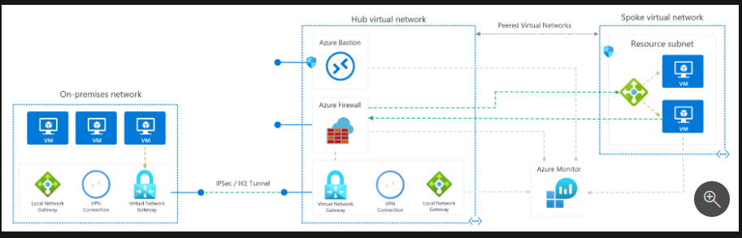
Hybrid Network

Slide 37
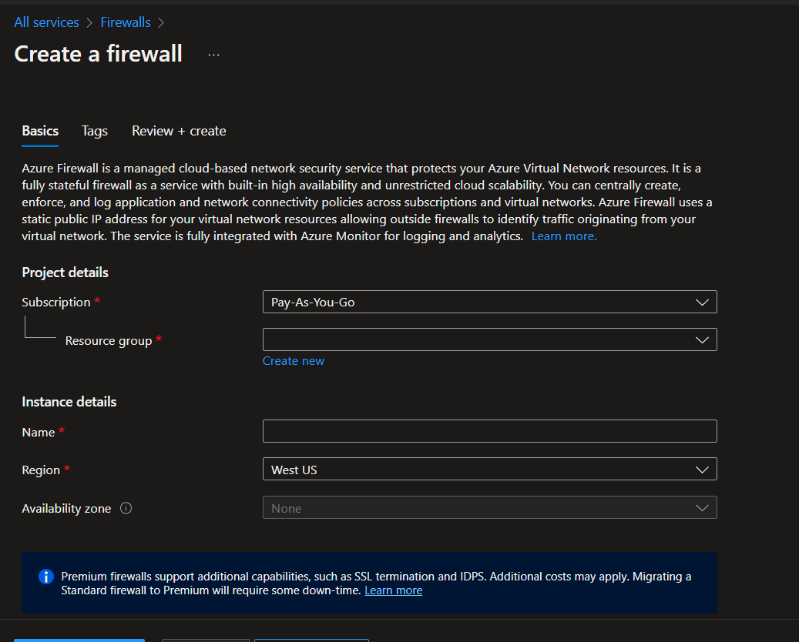

Slide 38
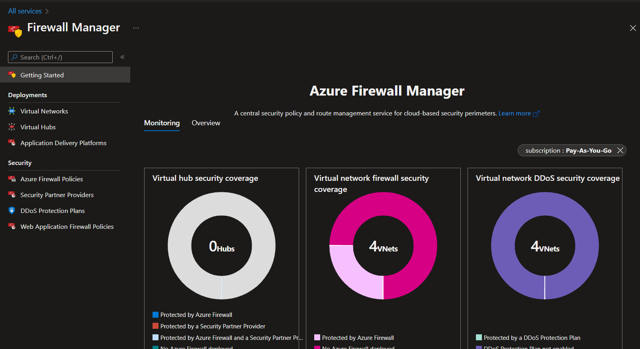

Slide 39
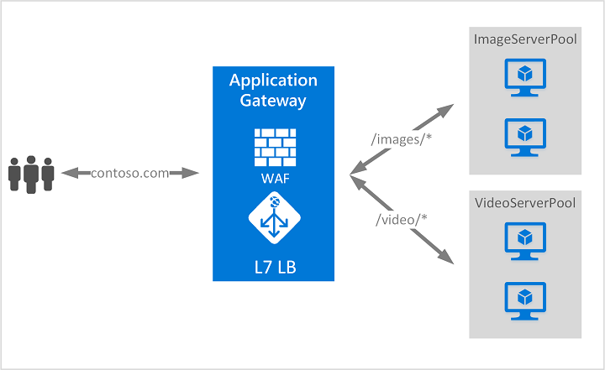

Slide 40
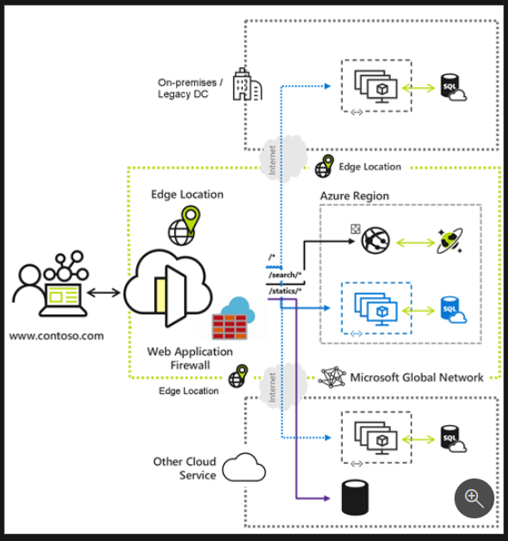

Slide 41
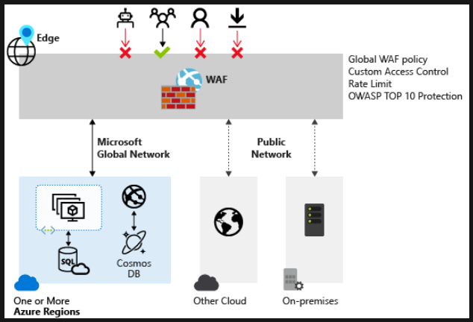

Slide 42
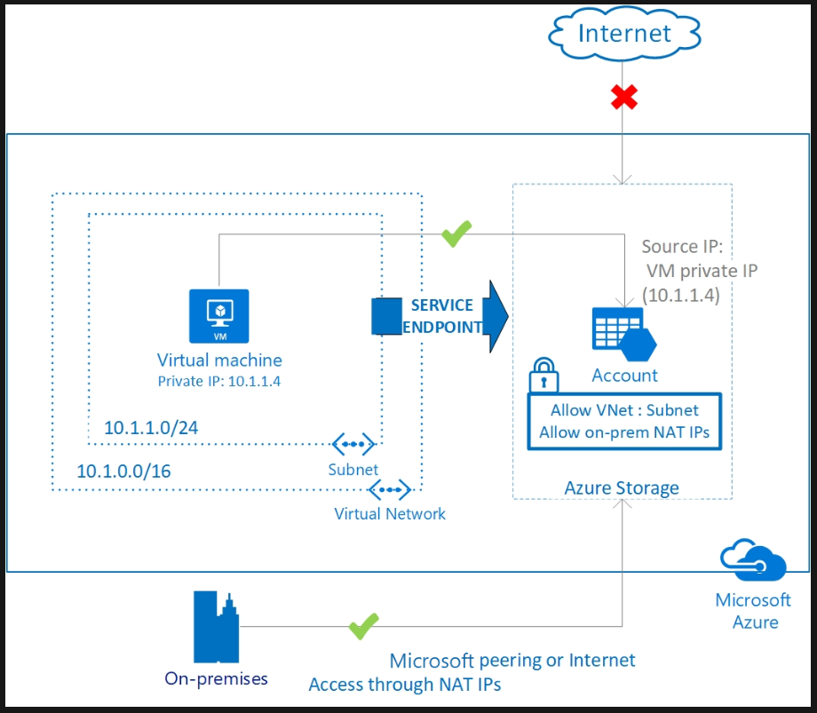

Slide 43
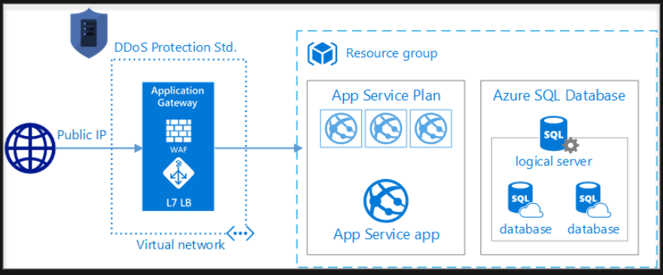

Slide 44
Configure Advanced Security for Compute
Configure Endpoint Protection for virtual machines (VMs)
Implement and manage security updates for VMs
Configure security for container services
Manage access to Azure Container Registry
Configure security for serverless compute
Configure security for an Azure App Service
Configure encryption at rest
Configure encryption in transit

Slide 45
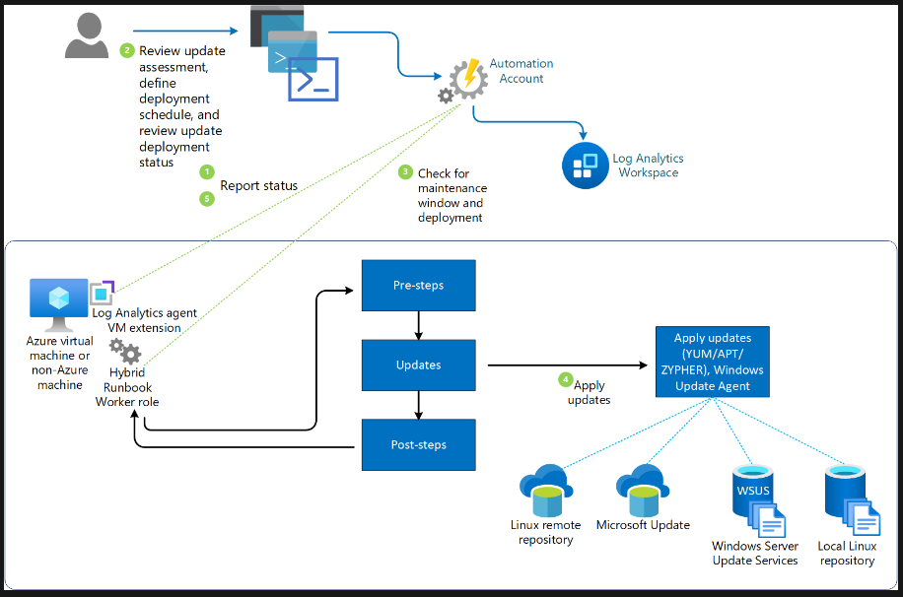

Slide 46
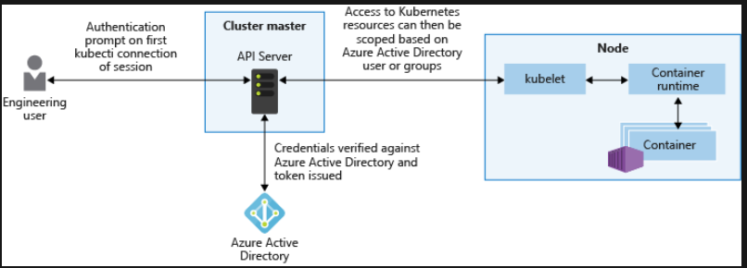

Slide 47
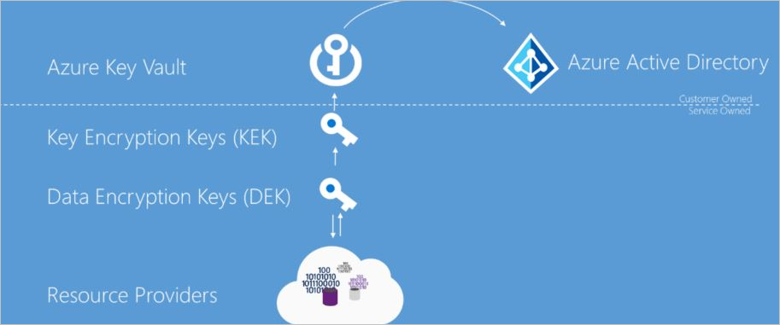

Slide 48
Day 2

Slide 49
Azure Fundamentals Bootcamp
Manage security operations (25–30%)
Secure data and applications (25–30%)

Slide 50
Manage Security Operations (25–30%)
Configure centralized policy management
Configure and manage threat protection
Configure and manage security monitoring solutions

Slide 51
Manage Security Operations
Configure centralized policy management
Configure and manage threat protection
Configure and manage security monitoring solutions

Slide 52
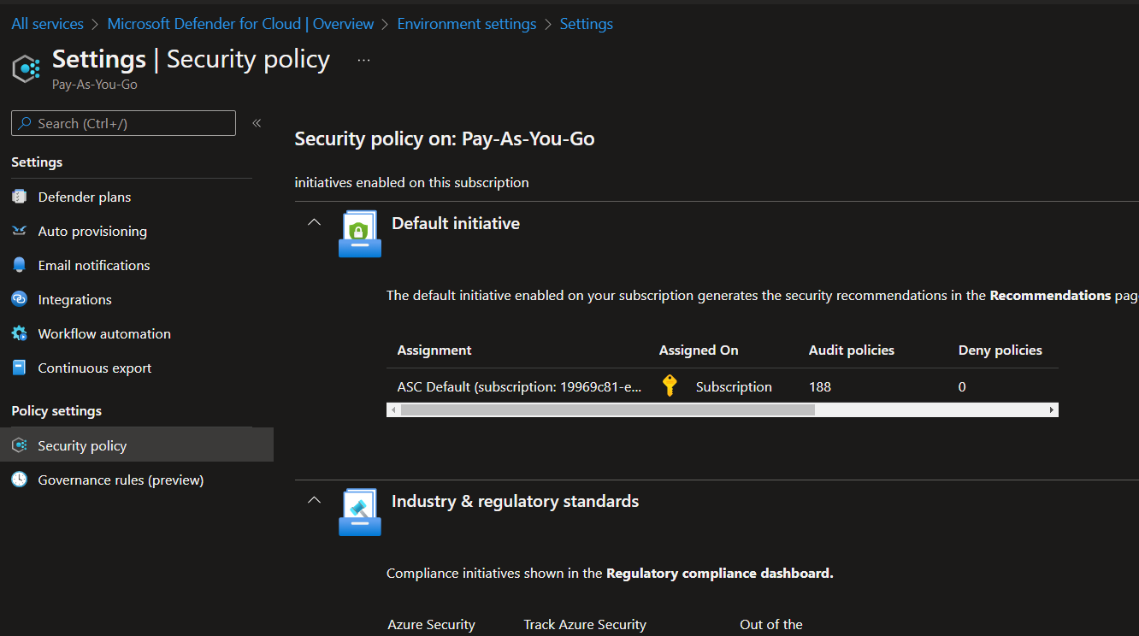

Slide 53
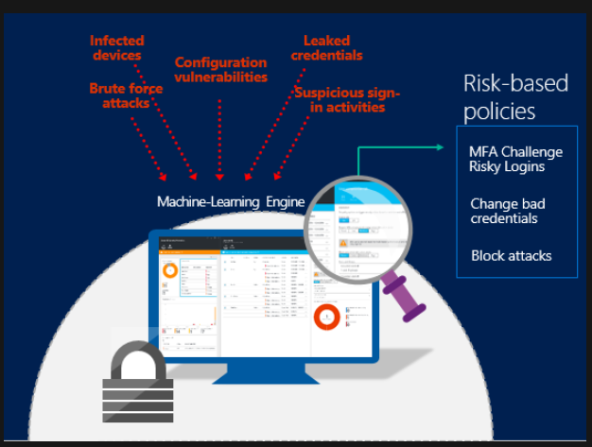

Slide 54
Configure Centralized Policy Management
Configure a custom security policy
Create a policy initiative
Configure security settings and auditing by using Azure Policy

Slide 55
Configure and Manage Threat Protection
Configure Microsoft Defender for Servers (not including Microsoft Defender for Endpoint)
Evaluate vulnerability scans from Microsoft Defender for Cloud
Configure Microsoft Defender for SQL
Use the Microsoft Threat Modeling Tool

Slide 56
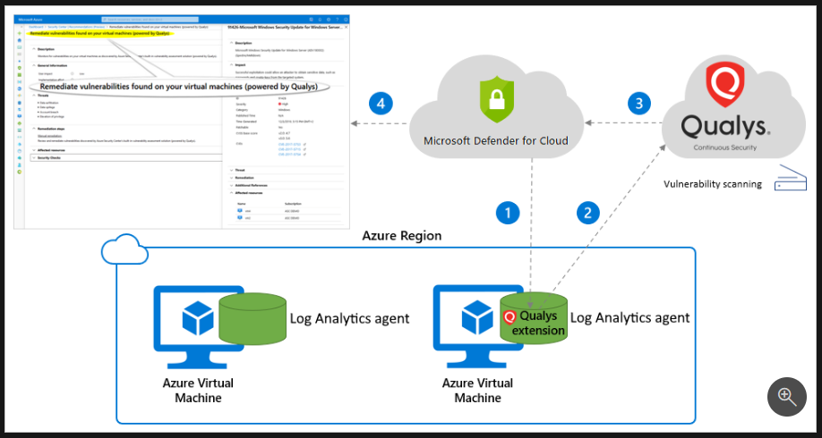

Slide 57
Configure and Manage Security Monitoring Solutions
Create and customize alert rules by using Azure Monitor
Configure diagnostic logging and log retention by using Azure Monitor
Monitor security logs by using Azure Monitor
Create and customize alert rules in Microsoft Sentinel
Configure connectors in Microsoft Sentinel
Evaluate alerts and incidents in Microsoft Sentinel

Slide 58
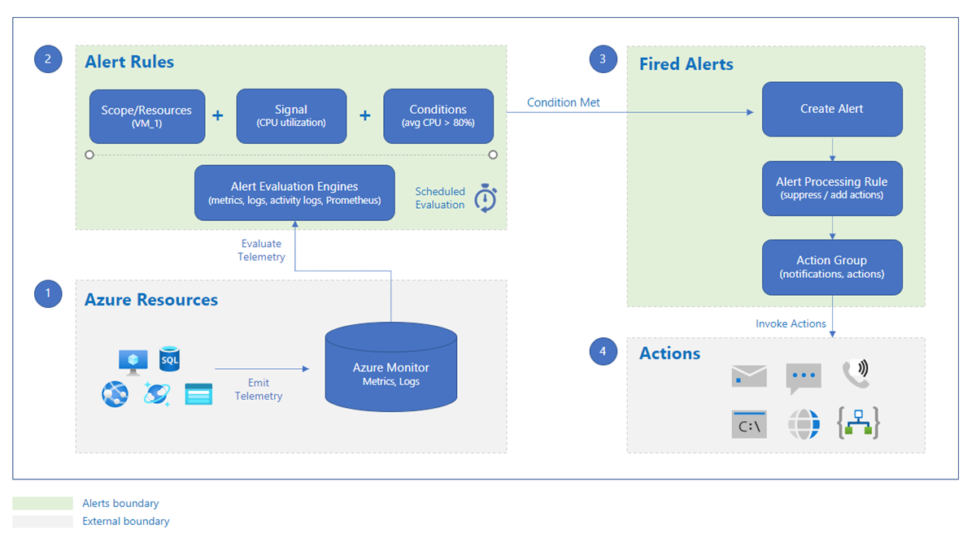

Slide 59
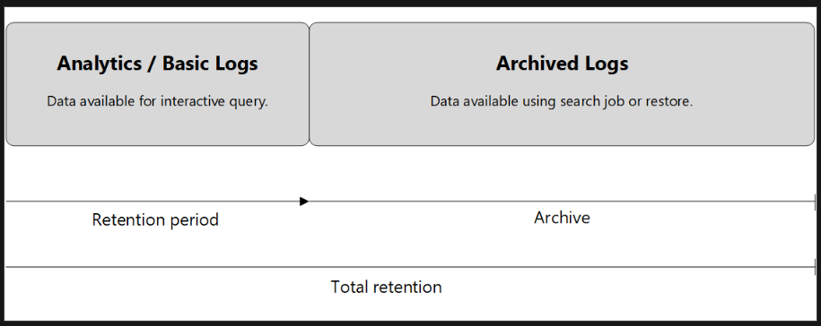

Slide 60
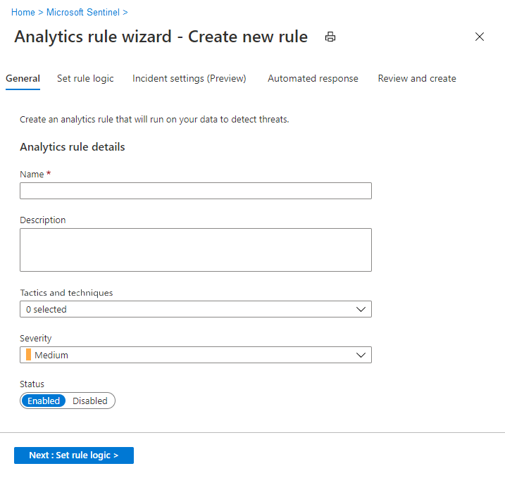

Slide 61
Secure Data and Applications (25–30%)
Configure security for storage
Configure security for data
Configure and manage Azure Key Vault

Slide 62
Configure Security for Storage
Configure access control for storage accounts
Configure storage account access keys
Configure Azure AD authentication for Azure Blobs and Azure Files
Configure delegated access

Slide 63
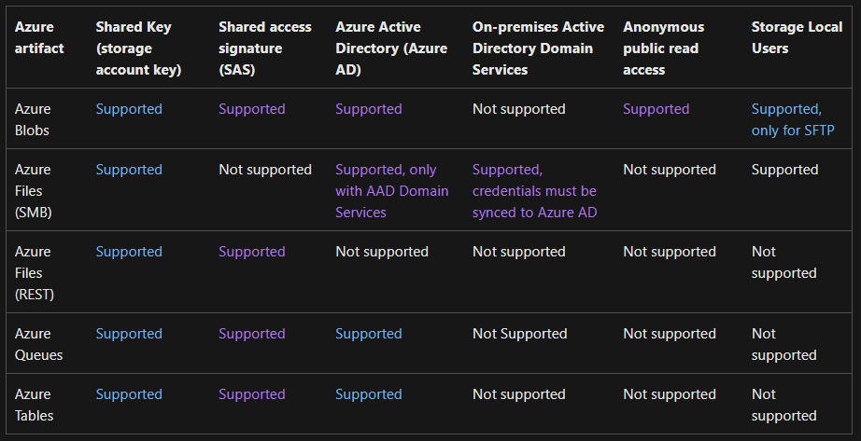

Slide 64
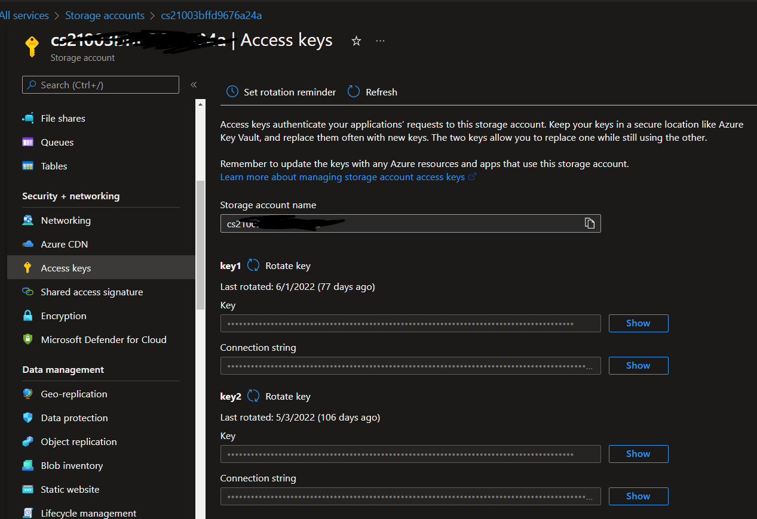

Slide 65
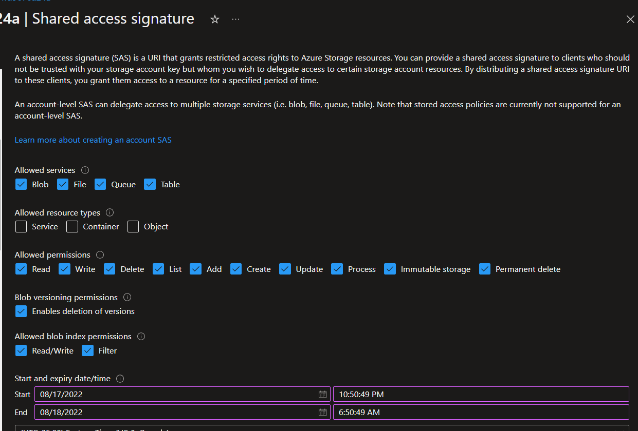

Slide 66
Configure Security for Data
Enable database authentication by using Azure AD
Enable database auditing
Configure dynamic masking on SQL workloads
Implement database encryption for Azure SQL Database
Implement network isolation for data solutions, including Azure Synapse Analytics and Azure Cosmos DB

Slide 67
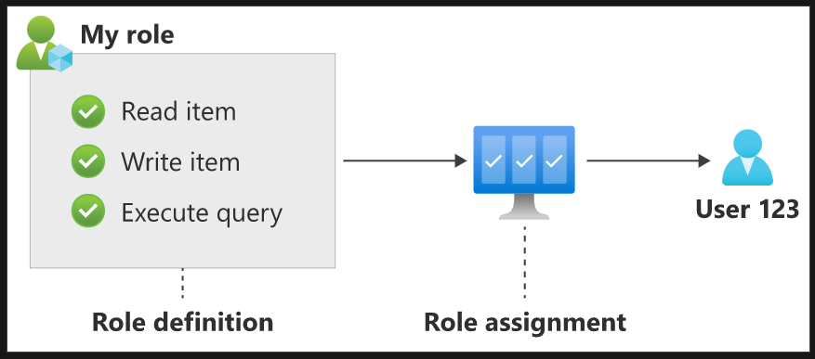

Slide 68
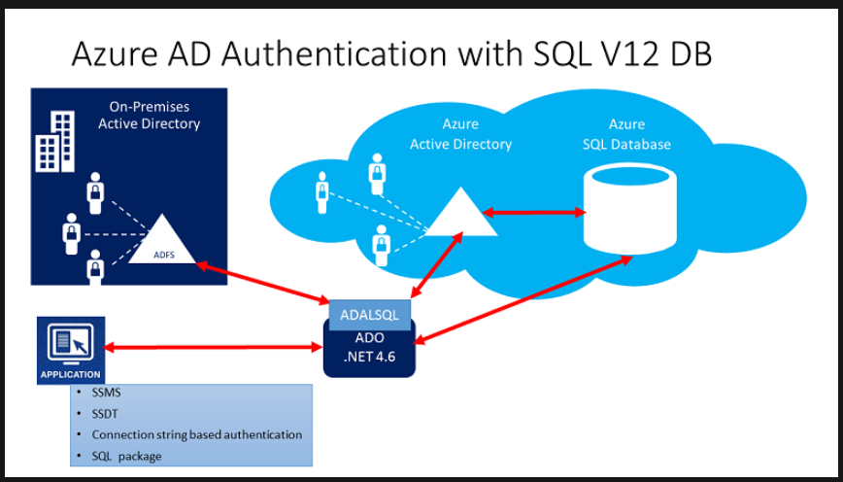

Slide 69
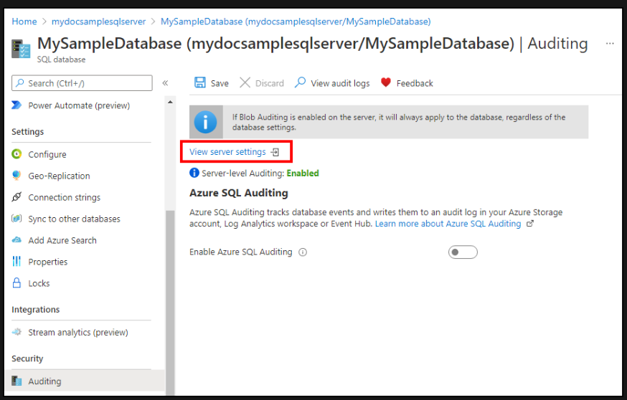

Slide 70
Configure and Manage Azure Key Vault
Create and configure Key Vault
Configure access to Key Vault
Manage certificates, secrets, and keys
Configure key rotation
Configure backup and recovery of certificates, secrets, and keys

Slide 71
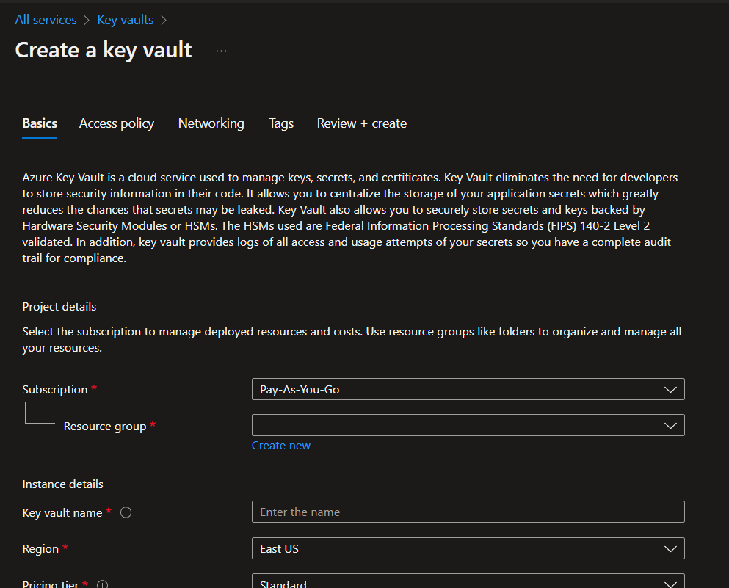

Slide 72
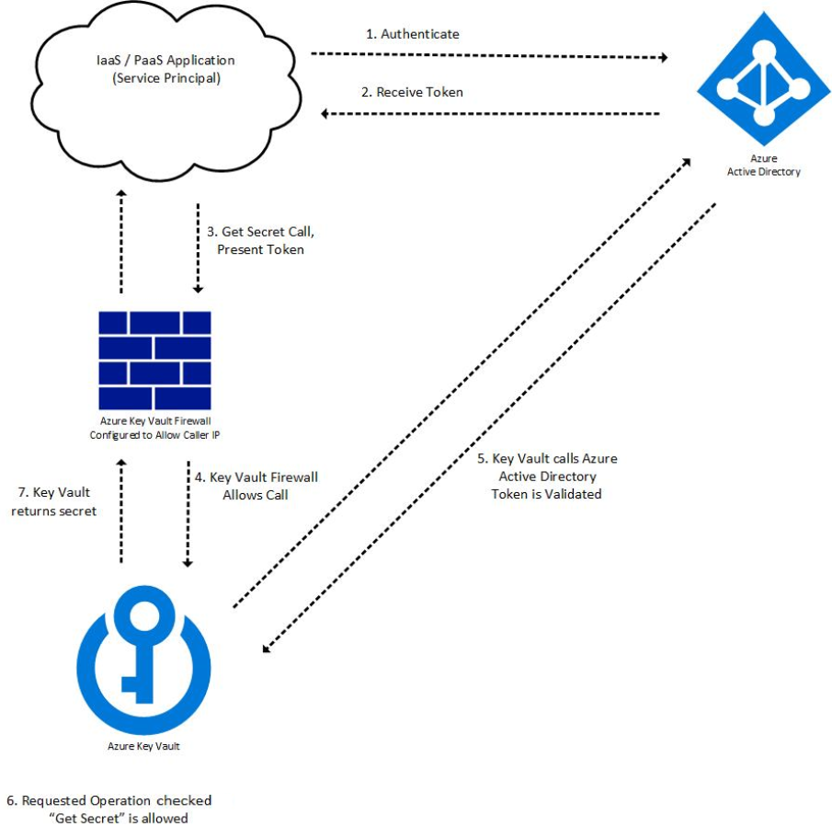

Slide 73
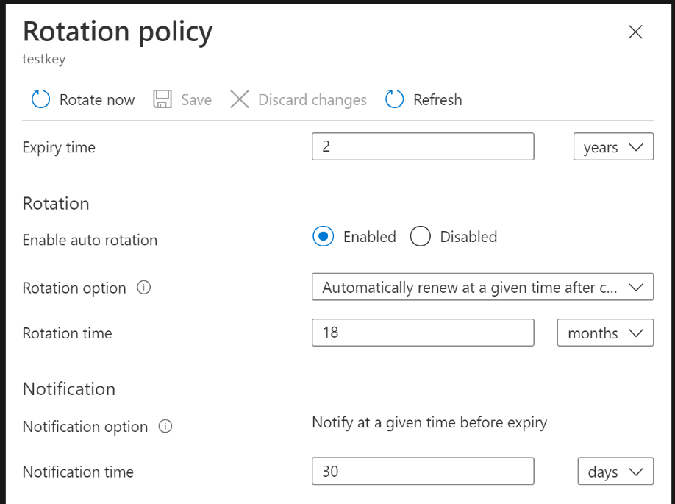

Slide 74
The Exam

Slide 75
Questions in AZ-500
Number of Questions ~45 Questions
Questions
Multiple choice
Drag and drop
Scenario based
There will NOT be hands-on labs but watch for updates!
Pass Score 700 (on a scale of 1-1000)

Slide 76
AZ-500
Exam AZ-500
Skills measured
AZ-500 Exam Prep videos
Demo the exam experience by visiting our Exam Sandbox

Slide 77
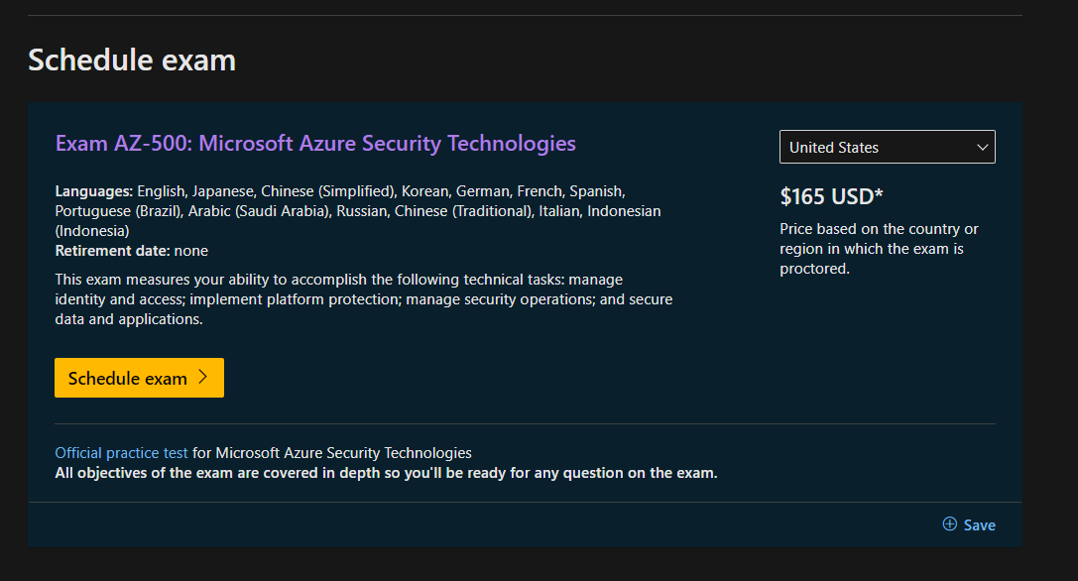

Slide 78

AI-100
Exam AI-100 : https://docs.microsoft.com/en-us/learn/certifications/exams/ai-100
Skills measured : https://query.prod.cms.rt.microsoft.com/cms/api/am/binary/RE3VC6C

Slide 79

AI-100
Exam AI-100 : https://docs.microsoft.com/en-us/learn/certifications/exams/ai-100
Skills measured : https://query.prod.cms.rt.microsoft.com/cms/api/am/binary/RE3VC6C

Slide 80

AI-100
Exam AI-100 : https://docs.microsoft.com/en-us/learn/certifications/exams/ai-100
Skills measured : https://query.prod.cms.rt.microsoft.com/cms/api/am/binary/RE3VC6C

Slide 81
AZ-500 Bootcamp Outcomes
Day 1
Manage identity and access
Implement platform protection
Day 2
Manage security operations
Secure data and applications

Slide 82
Course Repository
https://github.com/zaalion/oreilly-az-500

Slide 83
Q&A

Slide 84
Thank you!
Reza Salehi
@zaalion

